Slide 1

Mini-Project-IB Progress-I S.E. (Computer) Sem - IV
 | Agnel Charitie’s Fr.C.Rodrigues Institute of Technology,Vashi Computer Engineering Department
2022-23

Slide 2
FACE RECOGNITION ATTENDANCE SYSTEM WITH TEMPERATURE SENSING
Group members: [DSE 3]
Suhani Bhuti 1021166
Purvita Dhakad 1021168
Jaden Joseph 1021267
SamuelJosiah 1021270

Slide 3
Presentation Outline
About project
Design
Tool /technology used
Demonstration
Conclusion
References

Slide 4
ABOUT PROJECT
Face recognition attendance system is a very smart system which allows us to store data as well as mark the attendance in a user friendly way by using OpenCv, Tkinter and MySQL database.
We introduced a new feature of temperature sensing which allow us to sense our temperature along with recording attendance.
In this application user can input, update, delete or access all the details regarding the student. It can mark the attendance of the user and also import and export the csv file containing the attendance details.
It can measure our body temperature and also indicate if someone has higher temperature(>102deg Celsius)
Our project is divided into five parts
Login panel
Student management system
Face recognition
Attendance management system
Temperature sensing

Slide 5
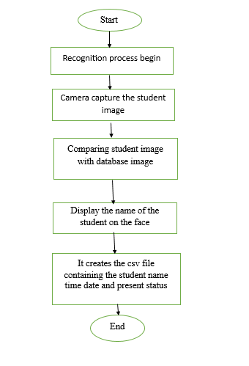
DESIGN
FACE RECOGNITION ATTENDANCE SYSTEM
Fig 1 Face recognition attendance system

Slide 6
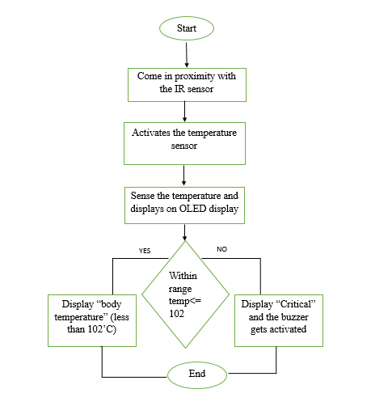
DESIGN
TEMPERATURE SENSING
Fig 2 Temperature sensing
Fig 4.2 Temperature sensing

Slide 7
TOOLS USED
Face recognition and attendance system:
Language: Python
Modules: Tkinter, OpenCv, Face recognition, Numpy, MySQL connector, Pillow, OS, datetime.
Temperature sensing:
Arduino nano
MLX90614 temperature sensor
IR sensor
OLED display
Piezo buzzer

Slide 8
IMPLEMENTATION

Slide 9
CONCLUSION
The attendance system are a better alternative for traditional practice of attendance sheet. It helps in reducing the wastage of paper used for marking the attendance by storing all the data in computer memory.
The rise in awareness about the virus spread make us take all the precautions and safety regarding the coronavirus, where temperature sensor helps us to tell the current body temperature.
Hence we have used face recognition concept to mark the attendance of student and make the system better.

Slide 10
REFERENCES
[1] Raj, R., Das, A., & Gupta, S. C,“Proposal of an Efficient Approach to Attendance Monitoring System using Bluetooth” 2019 9th International Conference on Cloud Computing, Data Science & Engineering(Confluence). doi:10.1109/confluence.2019.8776978
[2] Alam, M. J., Faisal, F., & Karim, A, “A Proposition for a Low-Cost Effective Attendance Management System”, 5th International Conference on Communication and Electronics Systems (ICCES). doi:10.1109/icces48766.2020.9137974, 2015.
[3] Saleem Ulla Shariff, Amaranatha C, Ravi Anand Jadhav, Dr. K Suresh Babu, Maheboob Hussain, “Face and Bio-Metric Based Attendance and Security System using RFID and Arduino”, International Journal of Electrical Electronics & Computer Science Engineering Special Issue - NEWS 2016, E-ISSN : 2348-2273, P-ISSN : 2454-1222.
[4] https://www.youtube.com/@codewithkiran

Slide 11
Thank You!

